Slide 1
Water4Otter
Check for Understanding
Lesson 3

Slide 2
Question #1:
What is wastewater?

Slide 3
Question #1:
What is wastewater?
Water in a pool
The dirty water that goes down our drains
Water no one needs
Rain water

Slide 4
Question #1:
What is wastewater?
Water in a pool
The dirty water that goes down our drains
Water no one needs
Rain water

Slide 5
Question #2:
Where does water go after it leaves our homes?

Slide 6
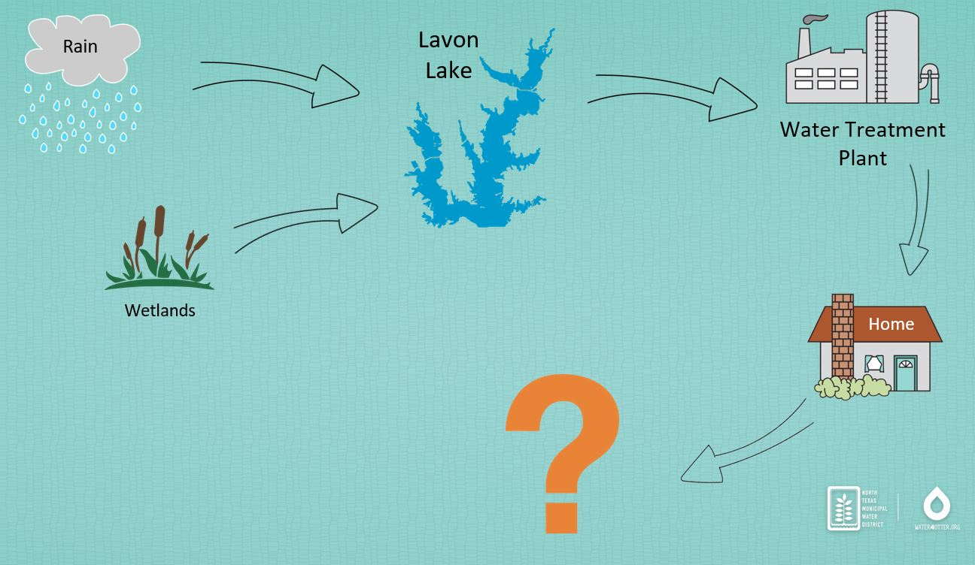
Question #2:
Where does water go after it leaves our homes?
Lavon Lake
Wetlands
Water Treatment Plant
Wastewater Treatment Plant

Slide 7
Question #2:
Where does water go after it leaves our homes?
Lavon Lake
Wetlands
Water Treatment Plant
Wastewater Treatment Plant

Slide 8
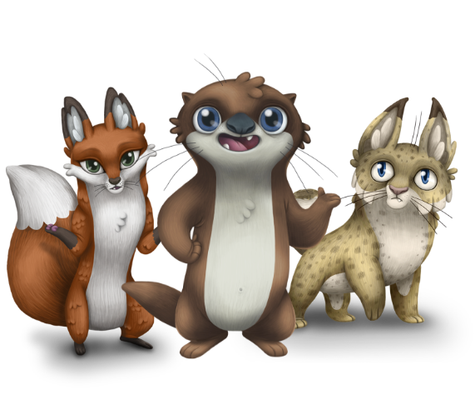
Question #3:
Otters, bobcats, red foxes, and humans all use water from Lavon Lake.
It’s all…...

Slide 9
Question #3:
Otters, bobcats, red foxes, and humans all use water from Lavon Lake.
It’s all…...
“One Wa t e r”

Slide 10
Question #3:
Otters, bobcats, red foxes, and humans all use water from Lavon Lake.
It’s all…...
“One Wa t e r”

Slide 11
Great job!

